Slide 1
DA_UNIT5

Slide 2
What’s the big idea??
We are going to be focusing on looking at each graph individually from project 3.
Think of questions we might have about the data being presented.
How we can improve the visualization to answer those questions.

Slide 3
What’s the point??
The point here is so, that we meaning me and you can better understand how to convey our data.
We want our points to be specific, meaningful, and clearly understood by the viewer.
Necessary data and not excess. Visualized by visualization.

Slide 4
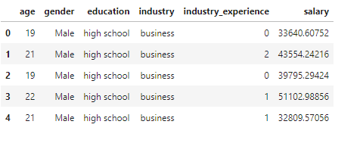
Improvement
Personally after analyzing this chart I can't really see the main point of it. So what I would do personally is change this to a bar chart. Where the salary would be the y axis, and industry exp would be the x axis. Then as industry exp is incremented we can see an increase in salary
Add a title, color, and improve overall visualization

Slide 5
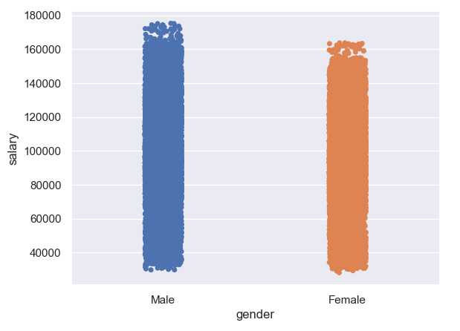
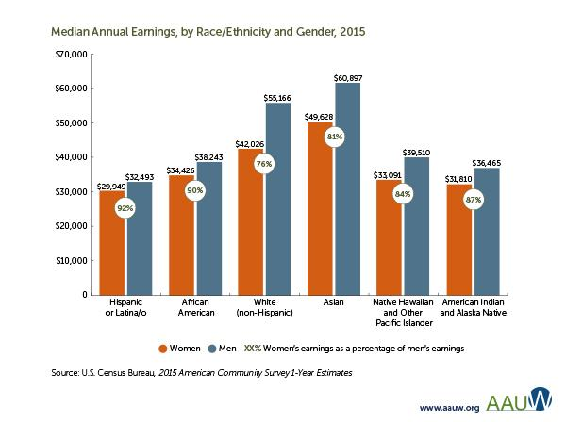
The graph that needs improvement is on the right. I actually found a great visualization that we can use to see how we would like to improve the one on the right
We can use a barchart and have male and female be side by side. Then with the data we are using we could show each different type of occupation that we have instead of race shown on the visualization to the left.

Slide 6
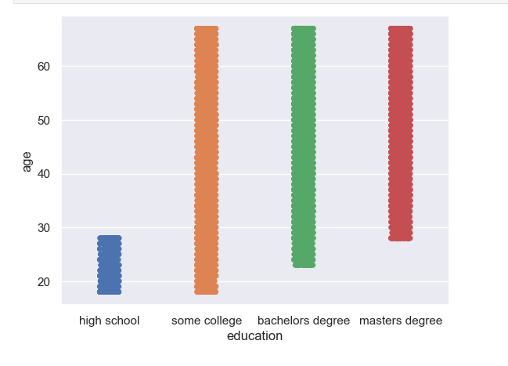
As you can see this is a stripplot. What I have deducted is that since we are looking at multiple series over a time period a line chart would be beneficial to visualization and better understanding of this graph.
Per usual we want a title that conveys we are comparing age with education.

Slide 7
Brief Report…
With the findings that I have gathered over this part of the project. I have come to realize just how important conveying your data can be. Not only with word of mouth but by visualizations as well. The idea that your visuals can tell a story and direct the viewer into seeing the most important parts of your data. Most of my findings came in ways of how to better communicate my data. Through eliminating unnecessary graph elements, formatting for impact, using appropriate colors, highlighting and drawing attention, background and foreground, informative words rather than descriptive, indicators, using a legend/text directed toward the graph, sentence summary, takeaways and action items, most importantly master the art of telling a story through your data.

Slide 8
DA_UNIT5

Slide 9
What’s the big idea??
We are going to be focusing on looking at each graph individually from project 3.
Think of questions we might have about the data being presented.
How we can improve the visualization to answer those questions.

Slide 10
What’s the point??
The point here is so, that we meaning me and you can better understand how to convey our data.
We want our points to be specific, meaningful, and clearly understood by the viewer.
Necessary data and not excess. Visualized by visualization.

Slide 11
Improvement
Personally after analyzing this chart I can't really see the main point of it. So what I would do personally is change this to a bar chart. Where the salary would be the y axis, and industry exp would be the x axis. Then as industry exp is incremented we can see an increase in salary
Add a title, color, and improve overall visualization

Slide 12
The graph that needs improvement is on the right. I actually found a great visualization that we can use to see how we would like to improve the one on the right
We can use a barchart and have male and female be side by side. Then with the data we are using we could show each different type of occupation that we have instead of race shown on the visualization to the left.

Slide 13
As you can see this is a stripplot. What I have deducted is that since we are looking at multiple series over a time period a line chart would be beneficial to visualization and better understanding of this graph.
Per usual we want a title that conveys we are comparing age with education.

Slide 14
Brief Report…
With the findings that I have gathered over this part of the project. I have come to realize just how important conveying your data can be. Not only with word of mouth but by visualizations as well. The idea that your visuals can tell a story and direct the viewer into seeing the most important parts of your data. Most of my findings came in ways of how to better communicate my data. Through eliminating unnecessary graph elements, formatting for impact, using appropriate colors, highlighting and drawing attention, background and foreground, informative words rather than descriptive, indicators, using a legend/text directed toward the graph, sentence summary, takeaways and action items, most importantly master the art of telling a story through your data.

